Slide 1
WK3 – Multi Layer Perceptron
CS 476: Networks of Neural Computation
WK3 – Multi Layer Perceptron
Dr. Stathis Kasderidis
Dept. of Computer Science
University of Crete
Spring Semester, 2009

Slide 2
Contents
MLP model details
Back-propagation algorithm
XOR Example
Heuristics for Back-propagation
Heuristics for learning rate
Approximation of functions
Generalisation
Model selection through cross-validation
Conguate-Gradient method for BP
Contents

Slide 3
Contents II
Advantages and disadvantages of BP
Types of problems for applying BP
Conclusions
Contents

Slide 4
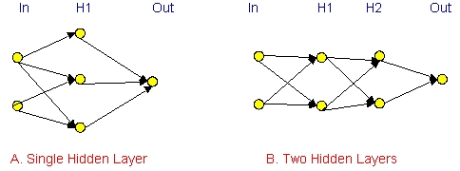
Multi Layer Perceptron
“Neurons” are positioned in layers. There are Input, Hidden and Output Layers
MLP Model

Slide 5
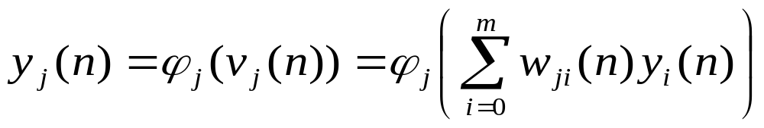
Multi Layer Perceptron Output
The output y is calculated by:
Where w₀(n) is the bias.
The function φ_{j}(•) is a sigmoid function. Typical examples are:
MLP Model

Slide 6
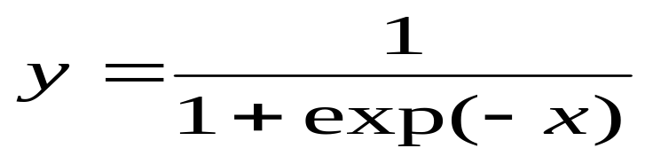
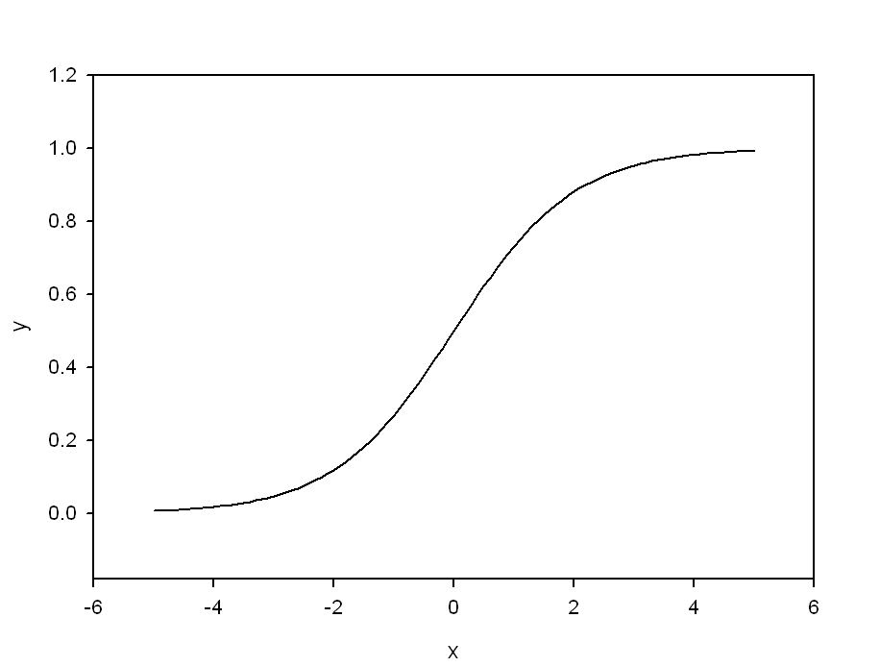
Transfer Functions
The logistic sigmoid:
MLP Model

Slide 7
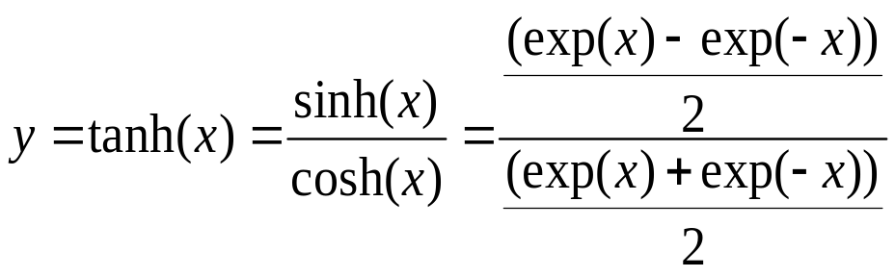
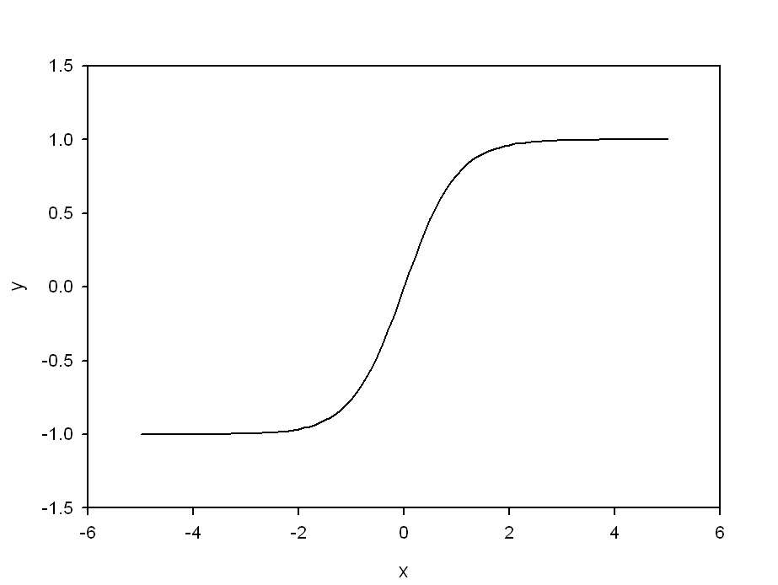
Transfer Functions II
The hyperbolic tangent sigmoid:
MLP Model

Slide 8
Learning Algorithm
Assume that a set of examples ℑ={x(n),d(n)}, n=1,…,N is given. x(n) is the input vector of dimension m₀ and d(n) is the desired response vector of dimension M
Thus an error signal, e_{j}(n)=d_{j}(n)-y_{j}(n) can be defined for the output neuron j.
We can derive a learning algorithm for an MLP by assuming an optimisation approach which is based on the steepest descent direction, I.e.
Δw(n)=-ηg(n)
Where g(n) is the gradient vector of the cost function and η is the learning rate.
BP Algorithm

Slide 9
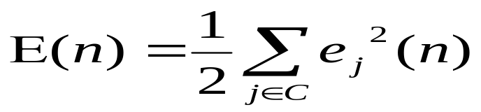
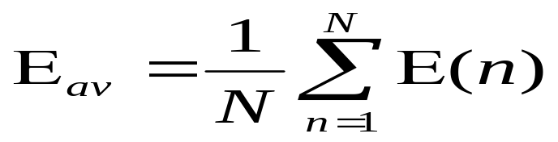
Learning Algorithm II
The algorithm that it is derived from the steepest descent direction is called back-propagation
Assume that we define a SSE instantaneous cost function (I.e. per example) as follows:
Where C is the set of all output neurons.
If we assume that there are N examples in the set ℑ then the average squared error is:
BP Algorithm

Slide 10
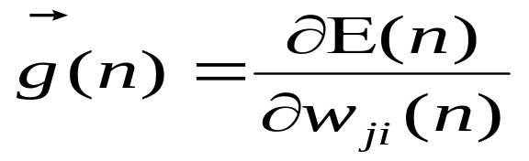
Learning Algorithm III
We need to calculate the gradient wrt E_{av} or wrt to E(n). In the first case we calculate the gradient per epoch (i.e. in all patterns N) while in the second the gradient is calculated per pattern.
In the case of E_{av} we have the Batch mode of the algorithm. In the case of E(n) we have the Online or Stochastic mode of the algorithm.
Assume that we use the online mode for the rest of the calculation. The gradient is defined as:
BP Algorithm

Slide 11
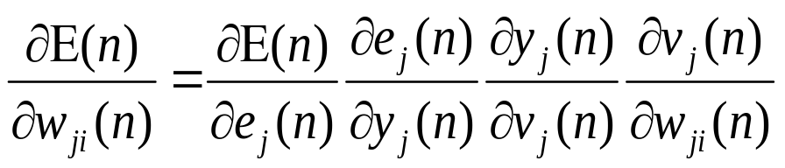
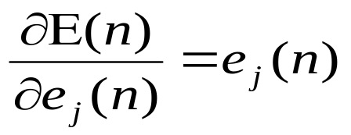
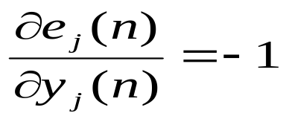
Learning Algorithm IV
Using the chain rule of calculus we can write:
We calculate the different partial derivatives as follows:
BP Algorithm

Slide 12
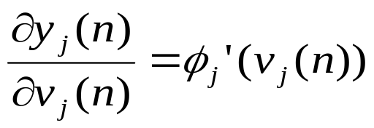
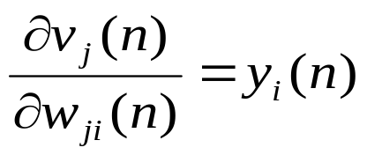
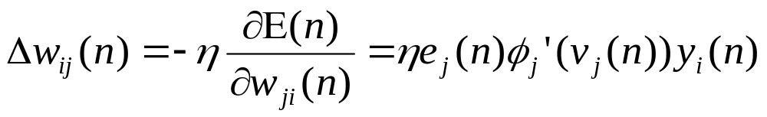
Learning Algorithm V
And,
Combining all the previous equations we get finally:
BP Algorithm

Slide 13
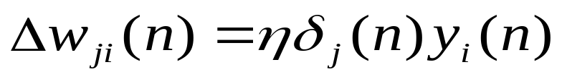
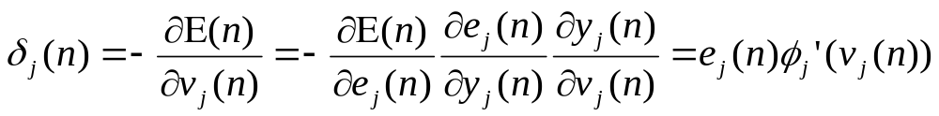
Learning Algorithm VI
The equation regarding the weight corrections can be written as:
Where δ_{j}(n) is defined as the local gradient and is given by:
We need to distinguish two cases:
  j is an output neuron
  j is a hidden neuron
BP Algorithm

Slide 14
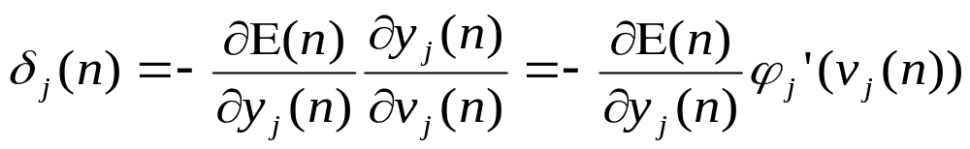
Learning Algorithm VII
Thus the Back-Propagation algorithm is an error-correction algorithm for supervised learning.
If j is an output neuron, we have already a definition of e_{j}(n), so, δ_{j}(n) is defined (after substitution) as:
If j is a hidden neuron then δ_{j}(n) is defined as:
BP Algorithm

Slide 15
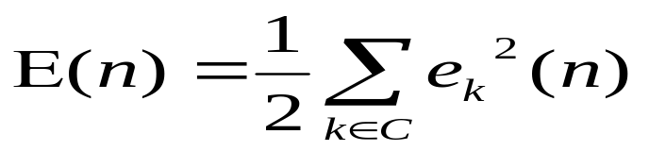
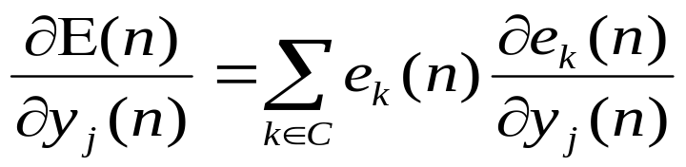
Learning Algorithm VIII
To calculate the partial derivative of E(n) wrt to y_{j}(n) we remember the definition of E(n) and we change the index for the output neuron to k, i.e.
Then we have:
BP Algorithm

Slide 16
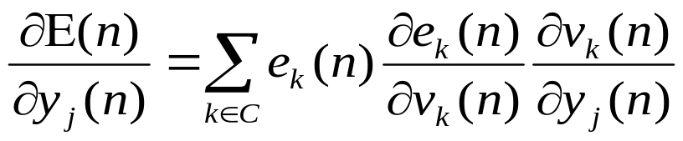
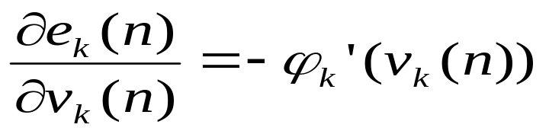
Learning Algorithm IX
We use again the chain rule of differentiation to get the partial derivative of e_{k}(n) wrt y_{j}(n):
Remembering the definition of e_{k}(n) we have:
Hence:
BP Algorithm

Slide 17
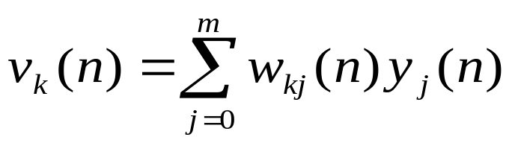
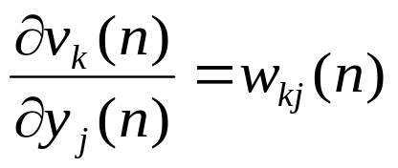
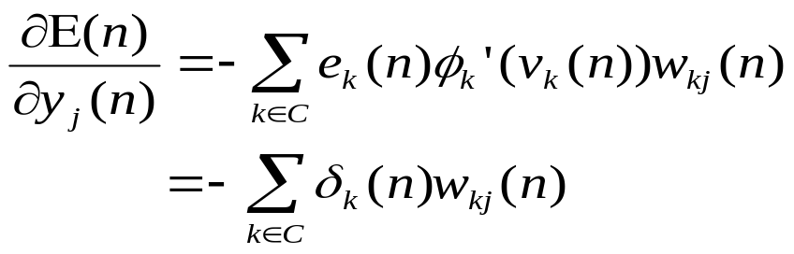
Learning Algorithm X
The local field v_{k}(n) is defined as:
Where m is the number of neurons (from the previous layer) which connect to neuron k. Thus we get:
Hence:
BP Algorithm

Slide 18
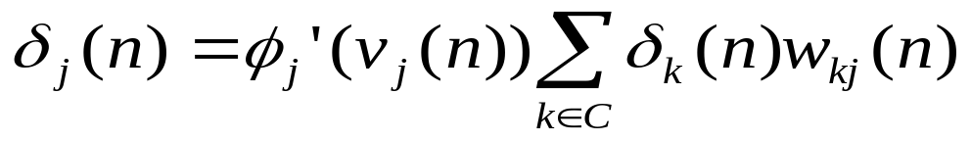
Learning Algorithm XI
Putting all together we find for the local gradient of a hidden neuron j the following formula:
It is useful to remember the special form of the derivatives for the logistic and hyperbolic tangent sigmoids:
  φ_{j}’(v_{j}(n))=y_{j}(n)[1-y_{j}(n)] (Logistic)
  φ_{j}’(v_{j}(n))=[1-y_{j}(n)][1+y_{j}(n)] (Hyp. Tangent)
BP Algorithm

Slide 19
Summary of BP Algorithm
Initialisation: Assuming that no prior infromation is available, pick the synaptic weights and thresholds from a uniform distribution whose mean is zero and whose variance is chosen to make the std of the local fields of the neurons lie at the transition between the linear and saturated parts of the sigmoid function
Presentation of training examples: Present the network with an epoch of training examples. For each example in the set, perform the sequence of the forward and backward computations described in points 3 & 4 below.
BP Algorithm

Slide 20
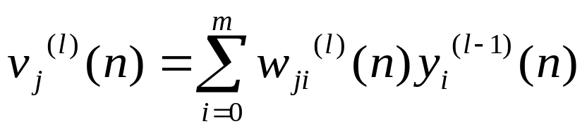
Summary of BP Algorithm II
Forward Computation:
  Let the training example in the epoch be denoted by (x(n),d(n)), where x is the input vector and d is the desired vector.
  Compute the local fields by proceeding forward through the network layer by layer. The local field for neuron j at layer l is defined as:
  where m is the number of neurons which connect to j and y_{i}^{(l-1)}(n) is the activation of neuron i at layer (l-1). W_{ji}^{(l)}(n) is the weight
BP Algorithm

Slide 21
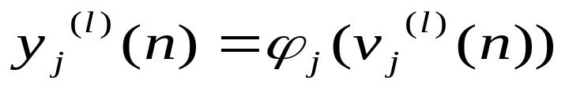
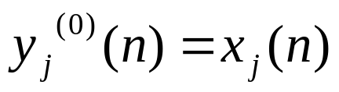
Summary of BP Algorithm III
which connects the neurons j and i.
  For i=0, we have y₀^{(l-1)}(n)=+1 and w_{j0}^{(l)}(n)=b_{j}^{(l)}(n) is the bias of neuron j.
  Assuming a sigmoid function, the output signal of the neuron j is:
  If j is in the input layer we simply set:
  where x_{j}(n) is the jth component of the input vector x.
BP Algorithm

Slide 22
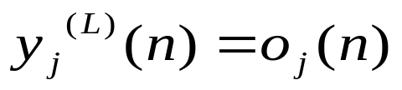
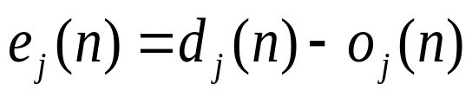
Summary of BP Algorithm IV
  If j is in the output layer we have:
  where o_{j}(n) is the jth component of the output vector o. L is the total number of layers in the network.
  Compute the error signal:
  where d_{j}(n) is the desired response for the jth element.
BP Algorithm

Slide 23
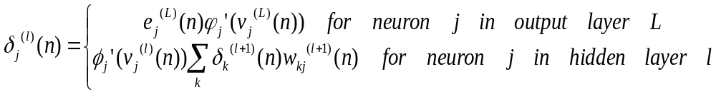
Summary of BP Algorithm V
Backward Computation:
  Compute the δs of the network defined by:
  where φ_{j}(•) is the derivative of function φ_{j} wrt the argument.
  Adjust the weights using the generalised delta rule:
  where α is the momentum constant
BP Algorithm

Slide 24
Summary of BP Algorithm VI
Iteration: Iterate the forward and backward computations of steps 3 & 4 by presenting new epochs of training examples until the stopping criterion is met.
The order of presentation of examples should be randomised from epoch to epoch
The momentum and the learning rate parameters typically change (usually decreased) as the number of training iterations increases.
BP Algorithm

Slide 25
Stopping Criteria
The BP algorithm is considered to have converged when the Euclidean norm of the gradient vector reaches a sufficiently small gradient threshold.
The BP is considered to have converged when the absolute value of the change in the average square error per epoch is sufficiently small
BP Algorithm

Slide 26
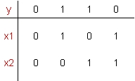
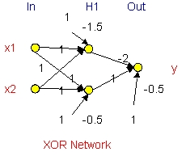
XOR Example
The XOR problem is defined by the following truth table:
The following network solves the problem. The perceptron could not do this. (We use Sgn func.)
BP Algorithm

Slide 27
Heuristics for Back-Propagation
To speed the convergence of the back-propagation algorithm the following heuristics are applied:
  H1: Use sequential (online) vs batch update
  H2: Maximise information content
    Use examples that produce largest error
    Use example which very different from all the previous ones
  H3: Use an antisymmetric activation function, such as the hyperbolic tangent. Antisymmetric means:
  φ(-x)=- φ(x)
BP Algorithm

Slide 28
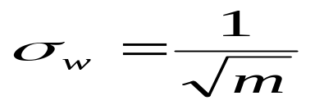
Heuristics for Back-Propagation II
  H4: Use different target values inside a smaller range, different from the asymptotic values of the sigmoid
  H5: Normalise the inputs:
    Create zero-mean variables
    Decorrelate the variables
    Scale the variables to have covariances approximately equal
  H6: Initialise properly the weights. Use a zero mean distribution with variance of:
BP Algorithm

Slide 29
Heuristics for Back-Propagation III
  where m is the number of connections arriving to a neuron
  H7: Learn from hints
  H8: Adapt the learning rates appropriately (see next section)
BP Algorithm

Slide 30
Heuristics for Learning Rate
  R1: Every adjustable parameter should have its own learning rate
  R2: Every learning rate should be allowed to adjust from one iteration to the next
  R3: When the derivative of the cost function wrt a weight has the same algebraic sign for several consecutive iterations of the algorithm, the learning rate for that particular weight should be increased.
  R4: When the algebraic sign of the derivative above alternates for several consecutive iterations of the algorithm the learning rate should be decreased.
BP Algorithm

Slide 31
Approximation of Functions
Q: What is the minimum number of hidden layers in a MLP that provides an approximate realisation of any continuous mapping?
A: Universal Approximation Theorem
Let φ(•) be a nonconstant, bounded, and monotone increasing continuous function. Let I_{m0} denote the m₀-dimensional unit hypercube [0,1]^{m0}. The space of continuous functions on I_{m0} is denoted by C(I_{m0}). Then given any function f ∈ C(I_{m0}) and ε > 0, there exists an integer m₁ and sets of real constants a_{i} , b_{i} and w_{ij} where i=1,…, m₁ and j=1,…, m₀ such that we may
Approxim.

Slide 32
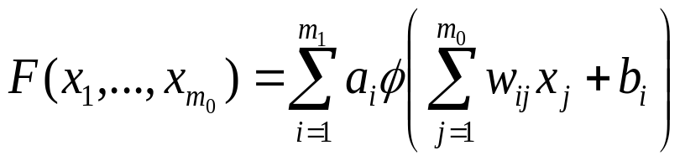
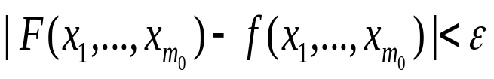
Approximation of Functions II
define:
as an approximate realisation of function f(•); that is:
for all x₁, …, x_{m0} that lie in the input space.
Approxim.

Slide 33
Approximation of Functions III
The Universal Approximation Theorem is directly applicable to MLPs. Specifically:
  The sigmoid functions cover the requirements for function φ
  The network has m₀ input nodes and a single hidden layer consisting of m₁ neurons; the inputs are denoted by x₁, …, x_{m0}
  Hidden neuron I has synaptic weights w_{i1}, …, w_{m0} and bias b_{i}
  The network output is a linear combination of the outputs of the hidden neurons, with a₁ ,…, a_{m1} defining the synaptic weights of the output layer
Approxim.

Slide 34
Approximation of Functions IV
The theorem is an existence theorem: It does not tell us exactly what is the number m₁; it just says that exists!!!
The theorem states that a single hidden layer is sufficient for an MLP to compute a uniform ε approximation to a given training set represented by the set of inputs x₁, …, x_{m0} and a desired output f(x₁, …, x_{m0}).
The theorem does not say however that a single hidden layer is optimum in the sense of the learning time, ease of implementation or generalisation.
Approxim.

Slide 35
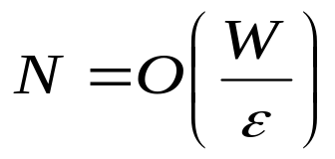
Approximation of Functions V
Empirical knowledge shows that the number of data pairs that are needed in order to achieve a given error level ε is:
Where W is the total number of adjustable parameters of the model. There is mathematical support for this observation (but we will not analyse this further!)
There is the “curse of dimensionality” for approximating functions in high-dimensional spaces.
It is theoretically justified to use two hidden layers.
Approxim.

Slide 36
Generalisation
Def: A network generalises well when the input-output mapping computed by the network is correct (or nearly so) for test data never used in creating or training the network. It is assumed that the test data are drawn form the population used to generate the training data.
We should try to approximate the true mechanism that generates the data; not the specific structure of the data in order to achieve the generalisation. If we learn the specific structure of the data we have overfitting or overtraining.
Model Selec.

Slide 37
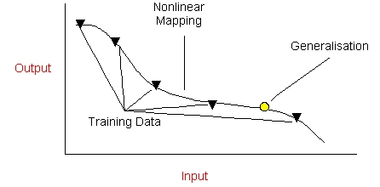
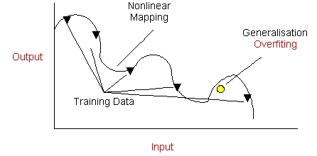
Generalisation II
Model Selec.

Slide 38
Generalisation III
To achieve good generalisation we need:
  To have good data (see previous slides)
  To impose smoothness constraints on the function
  To add knowledge we have about the mechanism
  Reduce / constrain model parameters:
    Through cross-validation
    Through regularisation (Pruning, AIC, BIC, etc)
Model Selec.

Slide 39
Cross Validation
In cross validation method for model selection we split the training data to two sets:
  Estimation set
  Validation set
We train our model in the estimation set.
We evaluate the performance in the validation set.
We select the model which performs “best” in the validation set.
Model Selec.

Slide 40
Cross Validation II
There are variations of the method depending on the partition of the validation set. Typical variants are:
  Method of early stopping
  Leave k-out
Model Selec.

Slide 41
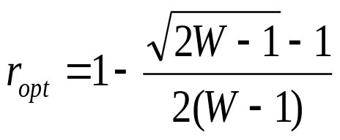
Method of Early Stopping
Apply the method of early stopping when the number of data pairs, N, is less than N<30W, where W is the number of free parameters in the network.
Assume that r is the ratio of the training set which is allocated to the validation. It can be shown that the optimal value of this parameter is given by:
The method works as follows:
  Train in the usual way the network using the data in the estimation set
Model Selec.

Slide 42
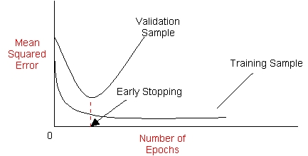
Method of Early Stopping II
  After a period of estimation, the weights and bias levels of MLP are all fixed and the network is operating in its forward mode only. The validation error is measured for each example present in the validation subset
  When the validation phase is completed, the estimation is resumed for another period (e.g. 10 epochs) and the process is repeated
Model Selec.

Slide 43
Leave k-out Validation
We divide the set of available examples into K subsets
The model is trained in all the subsets except for one and the validation error is measured by testing it on the subset left out
The procedure is repeated for a total of K trials, each time using a different subset for validation
The performance of the model is assessed by averaging the squared error under validation over all the trials of the experiment
There is a limiting case for K=N in which case the method is called leave-one-out.
Model Selec.

Slide 44
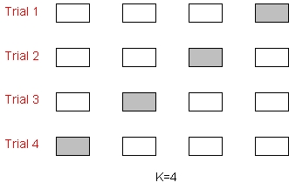
Leave k-out Validation II
An example with K=4 is shown below
Model Selec.

Slide 45
Network Pruning
To solve real world problems we need to reduce the free parameters of the model. We can achieve this objective in one of two ways:
  Network growing: in which case we start with a small MLP and then add a new neuron or layer of hidden neurons only when we are unable to achieve the performance level we want
  Network pruning: in this case we start with a large MLP with an adequate performance for the problem at hand, and then we prune it by weakening or eliminating certain weights in a principled manner
Model Selec.

Slide 46
Network Pruning II
Pruning can be implemented as a form of regularisation
Model Selec.

Slide 47
Regularisation
In model selection we need to balance two needs:
  To achieve good performance, which usually leads to a complex model
  To keep the complexity of the model manageable due to practical estimation difficulties and the overfitting phenomenon
A principled approach to the counterbalance both needs is given by regularisation theory.
In this theory we assume that the estimation of the model takes place using the usual cost function and a second term which is called complexity penalty:
Model Selec.

Slide 48
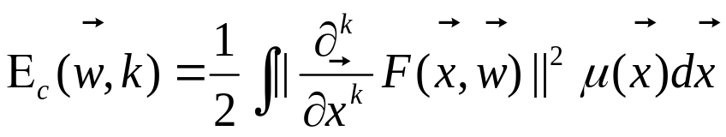
Regularisation II
R(w)=E_{s}(w)+λE_{c}(w)
Where R is the total cost function, E_{s} is the standard performance measure, E_{c} is the complexity penalty and λ>0 is a regularisation parameter
Typically one imposes smoothness constraints as a complexity term. I.e. we want to co-minimise the smoothing integral of the kth-order:
Where F(x,w) is the function performed by the model and μ(x) is some weighting function which determines
Model Selec.

Slide 49
Regularisation III
the region of the input space where the function F(x,w) is required to be smooth.
Model Selec.

Slide 50
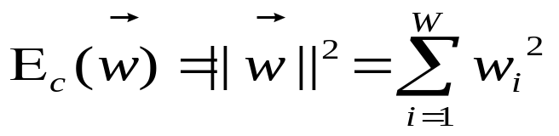
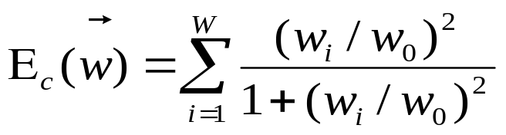
Regularisation IV
Other complexity penalty options include:
  Weight Decay:
  Where W is the total number of all free parameters in the model
  Weight Elimination:
  Where w₀ is a pre-assigned parameter
Model Selec.

Slide 51
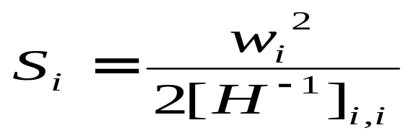
Regularisation V
There are other methods which base their decision on which weights to eliminate on the Hessian, H
For example:
  The optimal brain damage procedure (OBD)
  The optimal brain surgeon procedure (OBS)
    In this case a weight, w_{i}, is eliminated when:
    E_{av} < S_{i}
    Where S_{i} is defined as:
Model Selec.

Slide 52
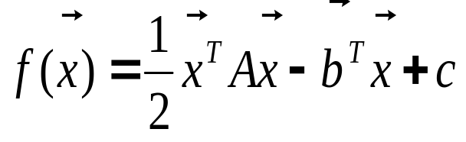
Conjugate-Gradient Method
The conjugate-gradient method is a 2nd order optimisation method, i.e. we assume that we can approximate the cost function up to second degree in the Taylor series:
Where A and b are appropriate matrix and vector and x is a W-by-1 vector
We can find the minimum point by solving the equations:
x* = A⁻¹b
BP & Opt.

Slide 53
Conjugate-Gradient Method II
Given the matrix A we say that a set of nonzero vectors s(0), …, s(W-1) is A-conjugate if the following condition holds:
s^{T}(n)As(j)=0 , ∀ n and j, n≠j
If A is the identity matrix, conjugacy is the same as orthogonality.
A-conjugate vectors are linearly independent
BP & Opt.

Slide 54
Summary of the Conjugate-Gradient Method
Initialisation: Unless prior knowledge on the weight vector w is available, choose the initial value w(0) using a procedure similar to the ones which are used for the BP algorithm
Computation:
  For w(0), use the BP to compute the gradient vector g(0)
  Set s(0)=r(0)=-g(0)
  At time step n, use a line search to find η(n) that minimises E_{av}(n) sufficiently, representing the cost function E_{av} expressed as a function of η for fixed values of w and s
BP & Opt.

Slide 55
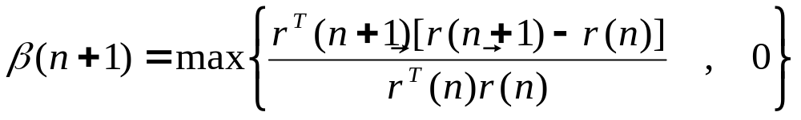
Summary of the Conjugate-Gradient Method II
  Test to determine if the Euclidean norm of the residual r(n) has fallen below a specific value, that is, a small fraction of the initial value ||r(0)||
  Update the weight vector:
  w(n+1)=w(n)+ η(n) s(n)
  For w(n+1), use the BP to compute the updated gradient vector g(n+1)
  Set r(n+1)=-g(n+1)
  Use the Polak-Ribiere formula to calculate β(n+1):
BP & Opt.

Slide 56
Summary of the Conjugate-Gradient Method III
  Update the direction vector:
  s(n+1)=r(n+1)+ β(n+1)s(n)
  Set n=n+1 and go to step 3
Stopping Criterion: Terminate the algorithm when the following condition is satisfied:
||r(n)|| ≤ ε ||r(0)||
Where ε is a prescribed small number
BP & Opt.

Slide 57
Advantages & Disadvantages
MLP and BP is used in Cognitive and Computational Neuroscience modelling but still the algorithm does not have real neuro-physiological support
The algorithm can be used to make encoding / decoding and compression systems. Useful for data pre-processing operations
The MLP with the BP algorithm is a universal approximator of functions
The algorithm is computationally efficient as it has O(W) complexity to the model parameters
The algorithm has “local” robustness
The convergence of the BP can be very slow, especially in large problems, depending on the method
Conclusions

Slide 58
Advantages & Disadvantages II
The BP algorithm suffers from the problem of local minima
Conclusions

Slide 59
Types of problems
The BP algorithm is used in a great variety of problems:
  Time series predictions
  Credit risk assessment
  Pattern recognition
  Speech processing
  Cognitive modelling
  Image processing
  Control
  Etc
BP is the standard algorithm against which all other NN algorithms are compared!!
Conclusions

